Slide 1


Python for Beginners
Archer Infotech , PUNE
www.archerinfotech.in

Slide 2
Python – Regression

Slide 3
Regression Analysis
Regression analysis is a statistical method to model the relationship between a dependent (target) and independent (predictor) variables with one or more independent variables.
More specifically, Regression analysis helps us to understand how the value of the dependent variable is changing corresponding to an independent variable when other independent variables are held fixed.
It predicts continuous/real values such as temperature, age, salary, price, etc.

Slide 4
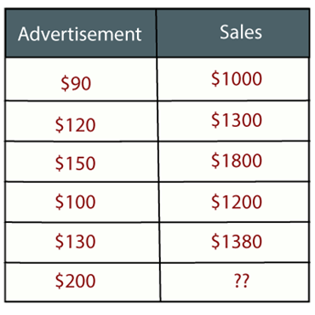
Regression Analysis
Regression is a supervised learning technique which helps in finding the correlation between variables and enables us to predict the continuous output variable based on the one or more predictor variables. It is mainly used for prediction, forecasting, time series modeling, and determining the causal-effect relationship between variables.

Slide 5
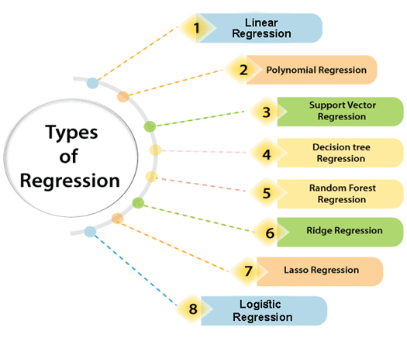
Types of Regressions

Slide 6
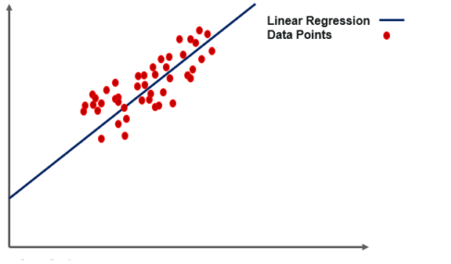
Single Linear Regression
Linear regression is a statistical regression method which is used for predictive analysis
Linear regression shows the linear relationship between the independent variable (X-axis) and the dependent variable (Y-axis), hence called linear regression
The straight line in the diagram is the best fit line.
The main goal of the simple linear regression is to consider the given data points and plot the best fit line to fit the model in the best way possible.

Slide 7
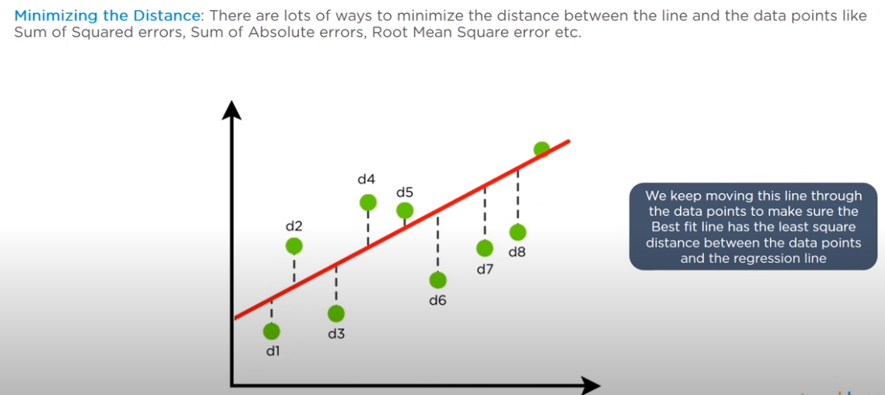
Regression Equation – Best Fit Line

Slide 8
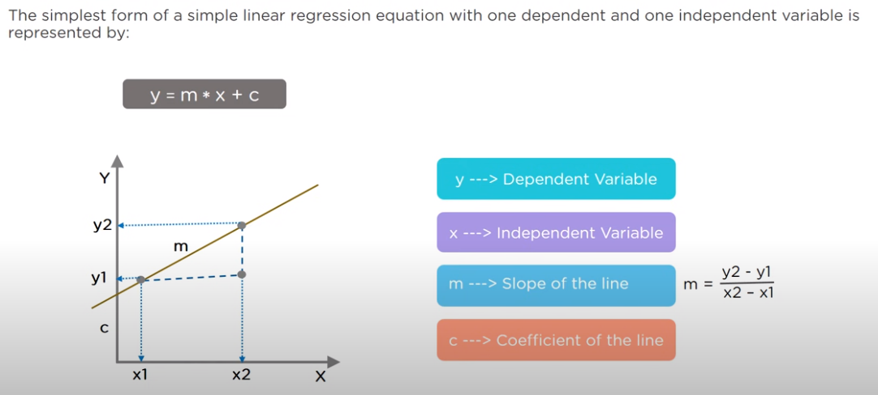
Regression Equation – Cost Function

Slide 9

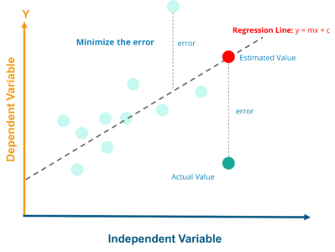
Least Square Method – Finding the best fit line
Least squares is a statistical method used to determine the best fit line or the regression line by minimizing the sum of squares created by a mathematical function. The “square” here refers to squaring the distance between a data point and the regression line. The line with the minimum value of the sum of square is the best-fit regression line.
Regression Line, y = mx+c where,
y = Dependent Variable
x= Independent Variable
c = y-Intercept

Slide 10
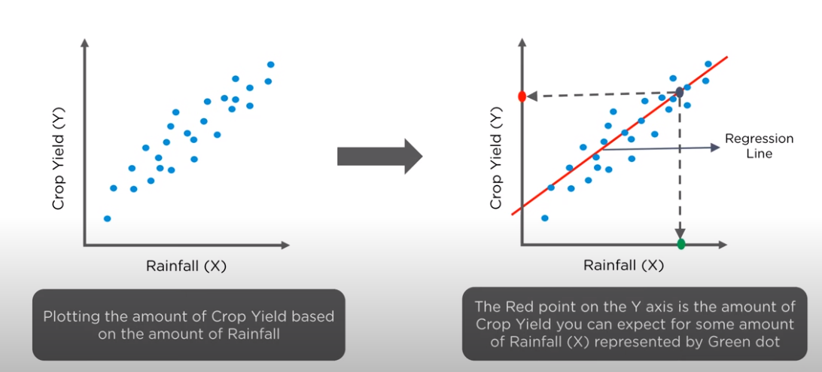
Prediction Using Regression Line

Slide 11
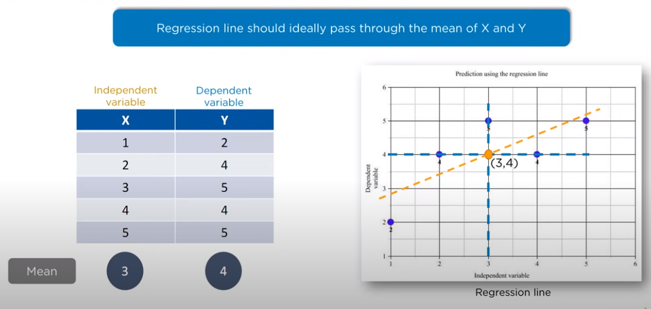
Regression Equation

Slide 12
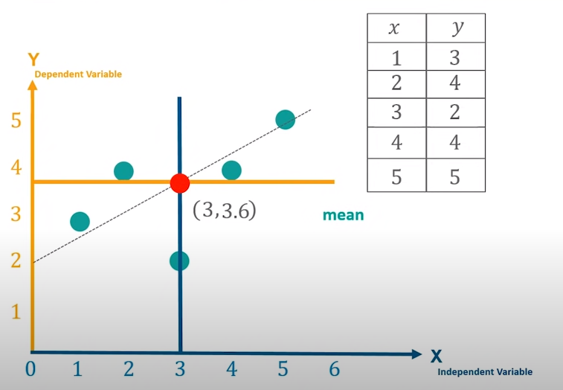
Regression Equation

Slide 13
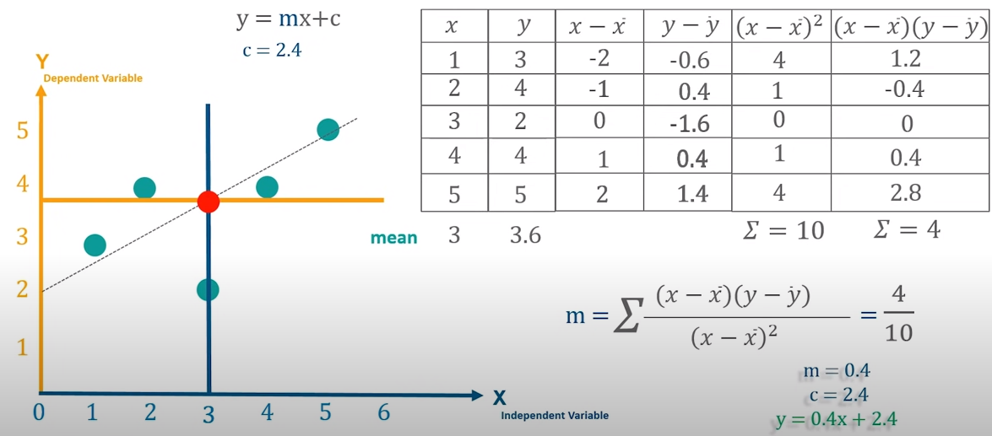
Regression Equation

Slide 14
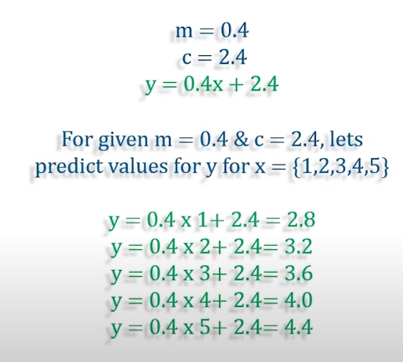
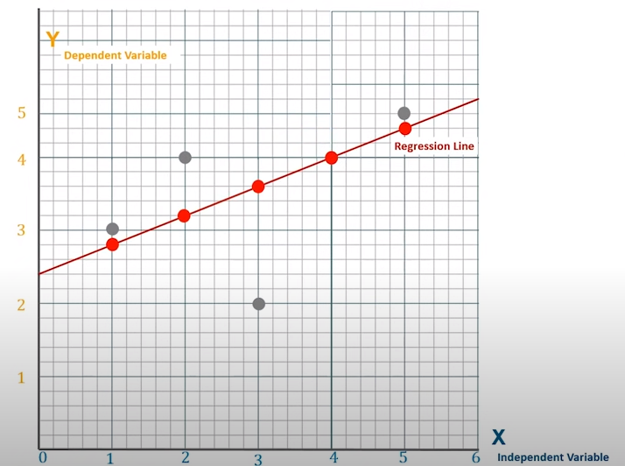
Regression Equation

Slide 15
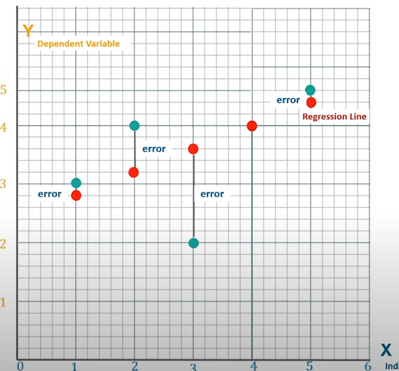
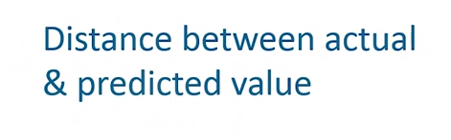
Regression Equation

Slide 16
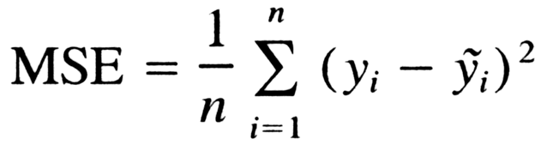
Regression Equation – Mean Square Error
For Linear Regression, we use the Mean Squared Error (MSE) cost function, which is the average of squared error occurred between the predicted values and actual values. It can be written as:

Slide 17
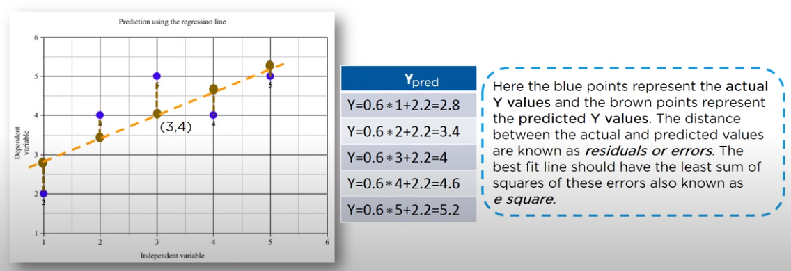
Regression Equation
Residuals: The distance between the actual value and predicted values is called residual. If the observed points are far from the regression line, then the residual will be high, and so cost function will high. If the scatter points are close to the regression line, then the residual will be small and hence the cost function.

Slide 18
Model Performance
R Squared Concept and Formula
R-Squared is also known as the Coefficient of Determination.
The value of R-Squared ranges from 0 to 1. The higher the R-Squared value of a model, the better is the model fitting on the data.
However, if the R-Squared value is very close to 1, then there is a possibility of model overfitting, which should be avoided.
A good model should have an R-Squared above 0.8.

Slide 19
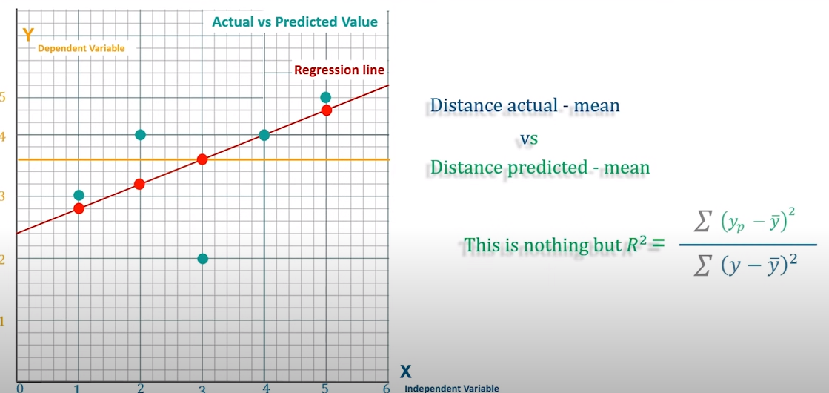
Calculation

Slide 20
Calculation

Slide 21
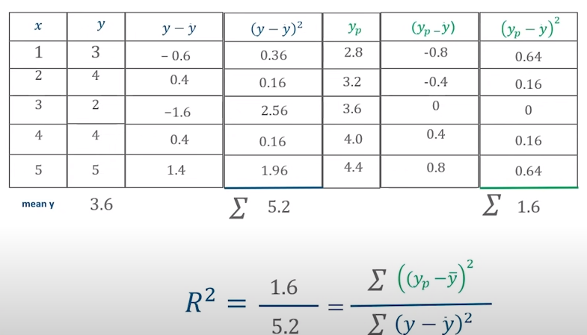
Calculation

Slide 22
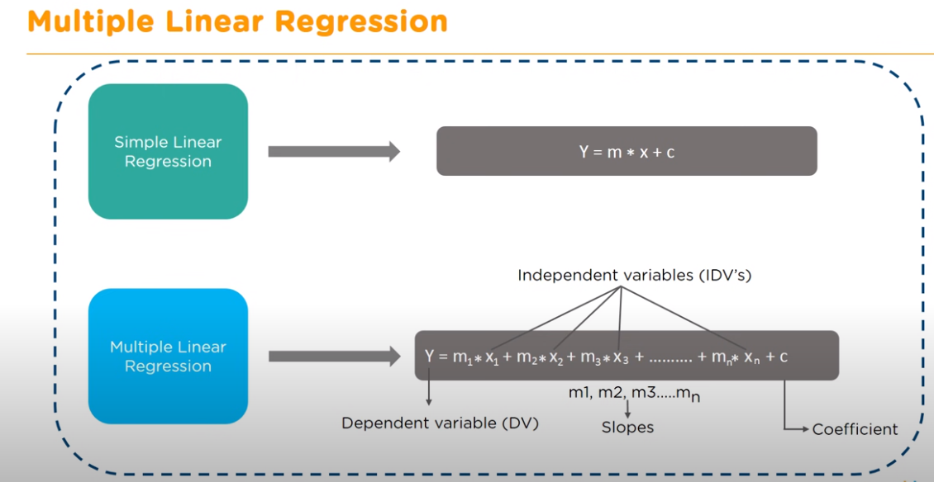
Multiple Linear Regression

Slide 23
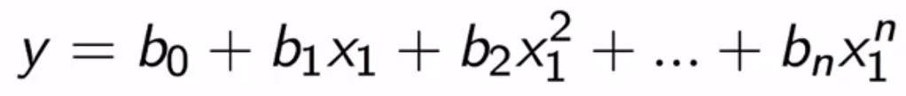
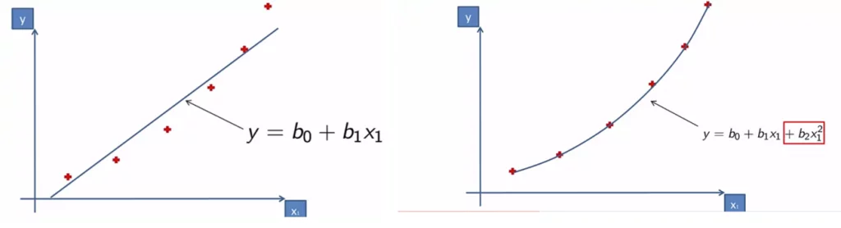
Polynomial Regression
Polynomial regression also a type of linear regression is often used to make predictions using polynomial powers of the independent variables

Slide 24
THANK YOU !!!
Amol Patil - 9822291613

